Slide 1
Data Stuctures and Algorithms
Dr. Fidaa Abed

Slide 2
Searching Algorithms
Linear Search
Binary search

Slide 3
Searching problem
Input: Array of n elements and a value x
Output: the index of the value x in the array, or -1 if x is not in the array

Slide 4
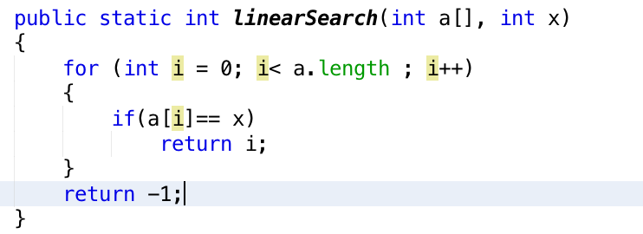
Linear Search

Slide 5
Linear Search Analysis
Best Case Analysis: O(1)
If x is the first element
Worst Case Analysis: O(n)
If x is the last element or x is not in the array
Average Case Analysis: O(n)
If x is in the middle of the array

Slide 6
Binary Search
The array has to be sorted
Much more efficient that linear search

Slide 7
Binary Search

Slide 8
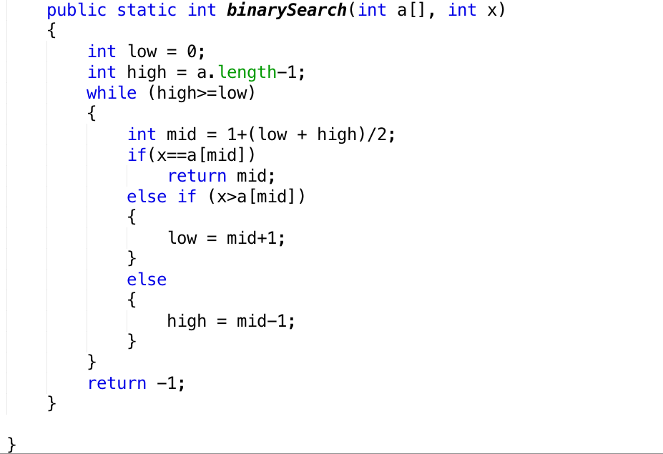
Binary Search

Slide 9
Binary Search Analysis
Every comparison we divide the search space by 2
If we start with 32 element
32-16-8-4-2-1 : we need 5 comparisons
This behaviour is the same as log n behaviour
O(log n) which is much faster that linear search
Remember the array has to be sorted

Slide 10
Exercises
Implement linear search
Implement Binary search using:
Iteration
Recursion

